Slide 1
Net Intrusion Detection
TEAM:
Ju***k
Yi***ng
Te**m

Slide 2
Overview
Task Introduction
Evaluation Metrics, Affecting Factors
Model Training: Random Forest, Softmax, NN,1D-CNN
Feature Selection + 2D-CNN
Conclusion

Slide 3
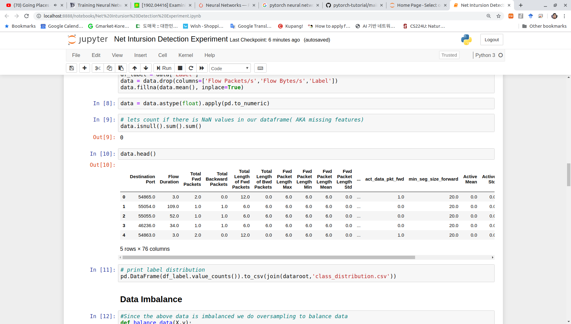
Definition Of the Task
Identifying flow which carries malicious traffic
Flow - (SourceIP,DestionationIP,SourcePort,DestinationPort,Protocol)
Flow information(features) in dataset - single row
76 features
2830749 samples
...

Slide 4
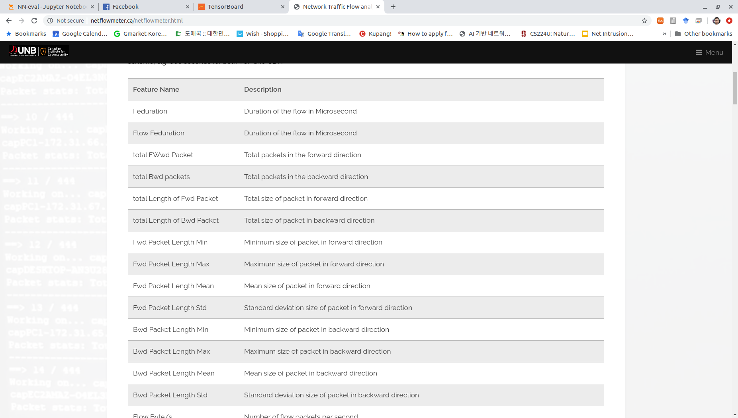
Feature Descriptions

Slide 5
Dataset
 | Flow Type | #flows
1 | BENIGN | 2,273,097
2 | DoS Hulk | 231,073
3 | PortScan | 158,930
4 | DDoS | 128,027
5 | DoS GoldenEye | 10,293
6 | FTP-Patator | 7,938
7 | SSH-Patator | 5,897
8 | DoS slowloris | 5,796
9 | DoS Slowhttptest | 5,499
10 | Bot | 1,966
11 | Web Attack � Brute Force | 1,507
12 | Web Attack � XSS | 652
13 | Infiltration | 36
14 | Web Attack � Sql Injection | 21
15 | Heartbleed | 11
 | Total | 2,830,743
Intrusion Detection Evaluation Dataset (CICIDS2017)
Emulated Data
Imbalanced data
76 features (flow statistics)
Why this dataset?
Contains 14 types of attacks
Relatively Recent

Slide 6
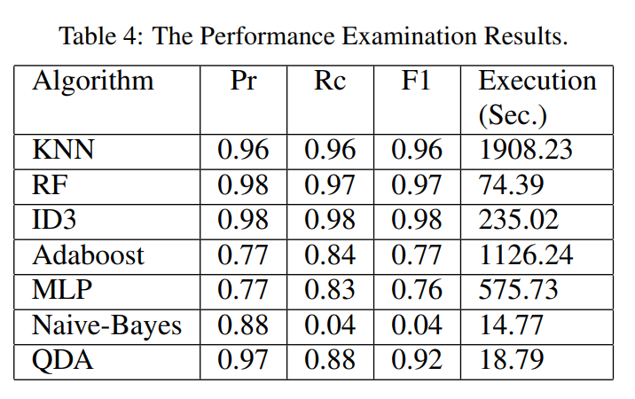
Motivation
Toward Generating a New Intrusion Detection Dataset and Intrusion Traffic Characterization (2018) ICISSP(International Conference on Information Systems Security and Privacy), 222 Citations
Issue:
Results are look unreasonable, and not clear how they obtained it
We suspect metrics are globally computed, we argue it is not right metric
We would like to investigate the results

Slide 7
Potential important factors
Evaluation metric - Use proper eval metric for Evaluation
Data imbalance - Handle it carefully(oversampling+undersampling)
Normalization
Randomness seed - use K-fold to mitigate

Slide 8
Random Forest(RF)
BENIGN | 2,273,097
DoS Hulk | 231,073
PortScan | 158,930
DDoS | 128,027
DoS GoldenEye | 10,293
FTP-Patator | 7,938
SSH-Patator | 5,897
DoS slowloris | 5,796
DoS Slowhttptest | 5,499
Bot | 1,966
Web Attack � Brute Force | 1,507
Web Attack � XSS | 652
Infiltration | 36
Web Attack � Sql Injection | 21
Heartbleed | 11
Imbalanced data is bad even for RF
We need to balance both train data and Validation Accuracy
Q: Is this results reliable?
A: I can Try different random seed to see it
Randomness SEED=5
Train data \Eval data | Val Accuracy | Balanced Val Accuracy | Balanced Test Acc
Imbalanced | 99.84 | 87.70 | 81.71
balanced | 99.83 | 89.37 | 83.51
+normalization | 99.31 | 90.03 | 85.72

Slide 9
Random Forest
BENIGN | 2,273,097
DoS Hulk | 231,073
PortScan | 158,930
DDoS | 128,027
DoS GoldenEye | 10,293
FTP-Patator | 7,938
SSH-Patator | 5,897
DoS slowloris | 5,796
DoS Slowhttptest | 5,499
Bot | 1,966
Web Attack � Brute Force | 1,507
Web Attack � XSS | 652
Infiltration | 36
Web Attack � Sql Injection | 21
Heartbleed | 11
Randomness SEED=2
Randomness SEED=5
Train Data / Eval Data | Val Accuracy | Balanced Val Accuracy | Balanced Test Acc
Imbalanced | 99.84 | 82.11 | 82.91
balanced | 99.83 | 83.93 | 85.41
+normalization | 98.64 | 85.89 | 89.29
Train Data / Eval Data | Val Accuracy | Balanced Val Accuracy | Balanced Test Acc
Imbalanced | 99.84 | 87.70 | 81.71
balanced | 99.83 | 89.37 | 83.51
+normalization | 99.31 | 90.03 | 85.72

Slide 10
Random Forest with 5-fold CV
BENIGN | 2,273,097
DoS Hulk | 231,073
PortScan | 158,930
DDoS | 128,027
DoS GoldenEye | 10,293
FTP-Patator | 7,938
SSH-Patator | 5,897
DoS slowloris | 5,796
DoS Slowhttptest | 5,499
Bot | 1,966
Web Attack � Brute Force | 1,507
Web Attack � XSS | 652
Infiltration | 36
Web Attack � Sql Injection | 21
Heartbleed | 11
Randomness SEED=2
Randomness SEED=5
Train data | Val Accuracy | Balanced Val Accuracy | Balanced Test Acc
Imbalanced | 99.86 | 83.55 | 78.11
balanced | 99.83 | 87.17 | 83.20
norm+balancing | 99.21 | 88.15 | 84.41
Train data | Val Accuracy | Balanced Val Accuracy | Balanced Test Acc
Imbalanced | 99.86 | 82.00 | 78.55
balanced | 99.83 | 84.23 | 82.47
norm+balancing | 99.23 | 87.29 | 85.08
Metrics we will use
Notes:
Deleted sklearn normalization row because there is not much difference when K-fold CV is done

Slide 11
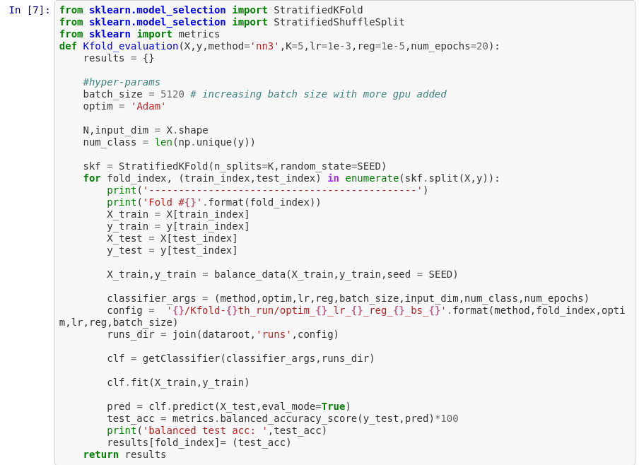
Importance of K fold evaluation
train/test = 4/1 from data set
dev/val = 4/1 from train set

Slide 12
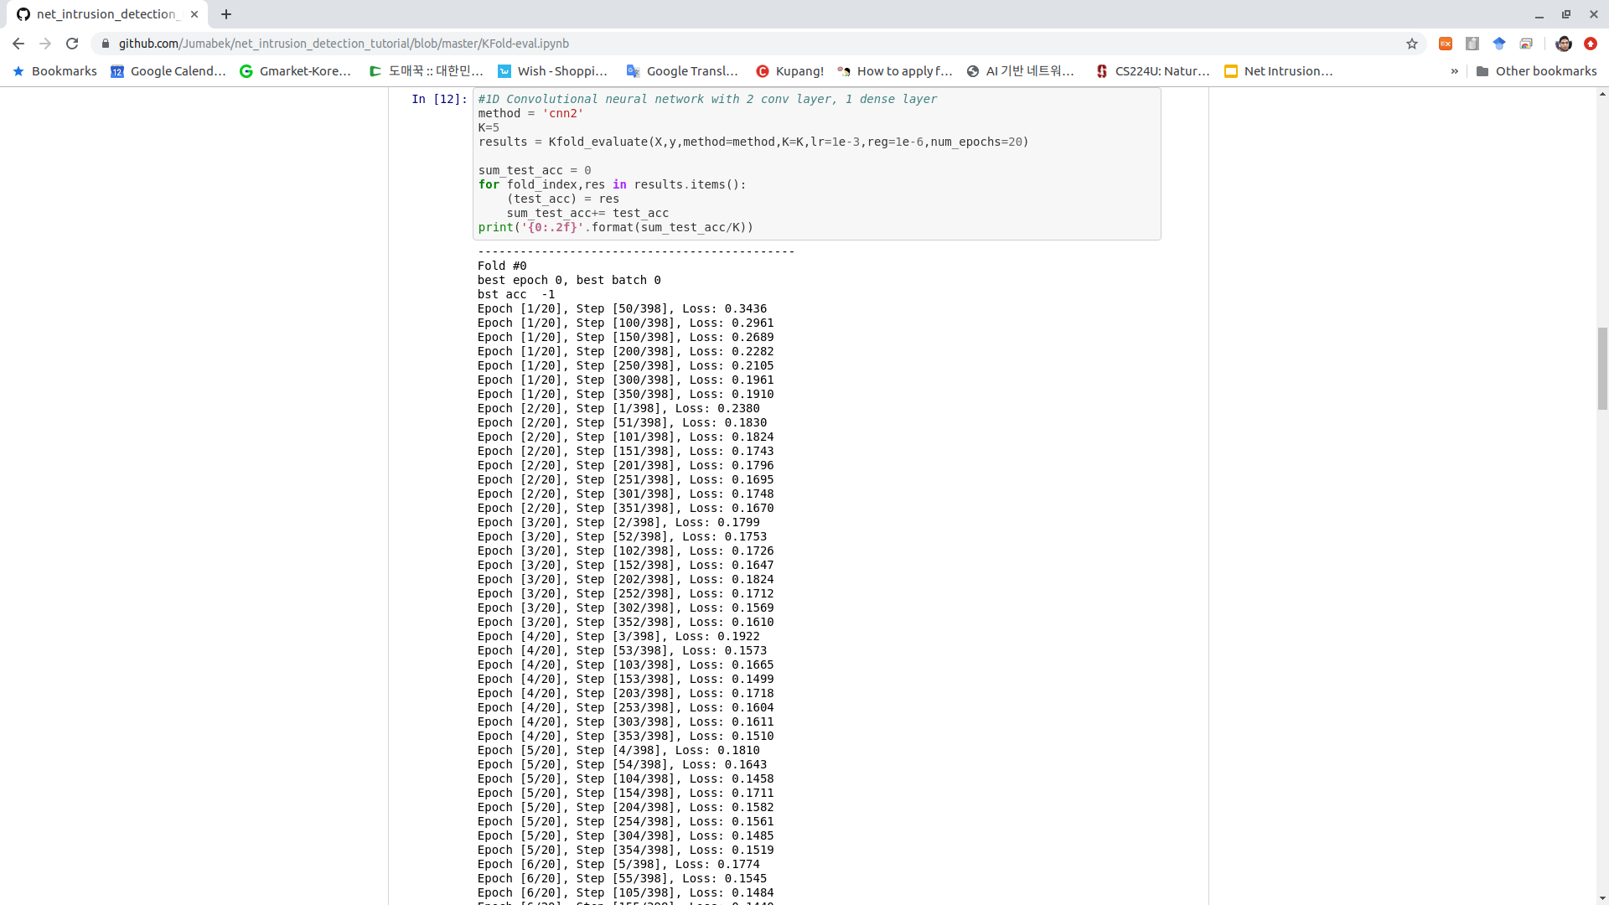
Importance of K fold evaluation
5-Fold results for 1D-CNN:
Fold #1: 79.69
Fold #2: 91.74
Fold #3: 88.39
Fold #4: 88.27
Fold #5: 85.45
5-fold(average): 86.71
Q: What is the reason for different accuracy?
A: Due to some classes having a small number of samples, and during the split where each sample ends up makes a difference

Slide 13
Experiment Setting(NN,1D-CNN,Linear Softmax)
Pytorch framework(for intuitive framework)
tuning hyper parameters such as lr, reg, num layers, hidden units, dropout,batchnorm
Fixed hyperparameters: batch_size =5120, optimizer=’Adam’
Tensorboard for loss/learning visualization

Slide 14
Training: Overview
Softmax:
Make model with 76(#features) x 15(#classes) weights with Softmax Loss
Cross validate best hyper param
NN:
Take random 3 layer NN
Cross validate best hyper param
Check the impact of batchnorm, dropout on selected model
With found configurations/techniques try 5 layer NN without CV(being responsible for CO emission)
1D-CNN:
Take 2 conv layer + 1 fc layer
Tune hyper parameters

Slide 15

Carbon footprint of training AI model
source: https://www.technologyreview.com/s/613630/training-a-single-ai-model-can-emit-as-much-carbon-as-five-cars-in-their-lifetimes/

Slide 16
Guide to Training responsibly
We are willing to trade-off some performance to reduce CO emission and save time
Actions:
Reduce number of epochs to be trained by using larger lr on smaller number of epochs
Perform Coarser CV. Do not try too much to find the best hyper-param

Slide 17
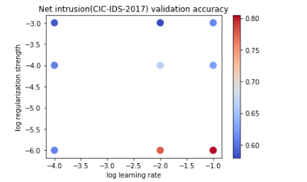
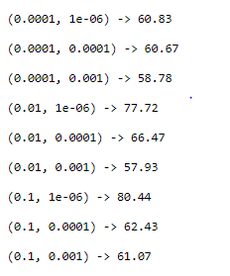
Softmax Classifier
Configurations:
Batch_size = 1024
learning_rates = [,1e-4,1e-2,1e-1]
regularizations = [1e-6,1e-4,1e-3]
Epoch = 25
Num of layers = 4
Training Accuracy on above hyperparameters:

Slide 18
Softmax Classifier
Test Accuracy for 5 folds:
79.9 % at fold=0
84.02 % at fold=1
80.8 % at fold=2
79.01% at fold=3
81.2% at fold=4
80.99% 5-Fold(avg)
Best Regularization rate is : [1e-6]
Best Learning rate is: [1e-1]

Slide 19
3 layer NN architecture
Number of layers 3: (INPUT_DIM x 128), (128x128), (128xNUM_CLASSES).
Technically, we can try multiple configuration of hidden units but I am limiting with random configuration because of computational cost (to reduce global warming)
Batch size 5120 - GPU mem constraint(Use as large as possible batch_size DNN class Inha)

Slide 20
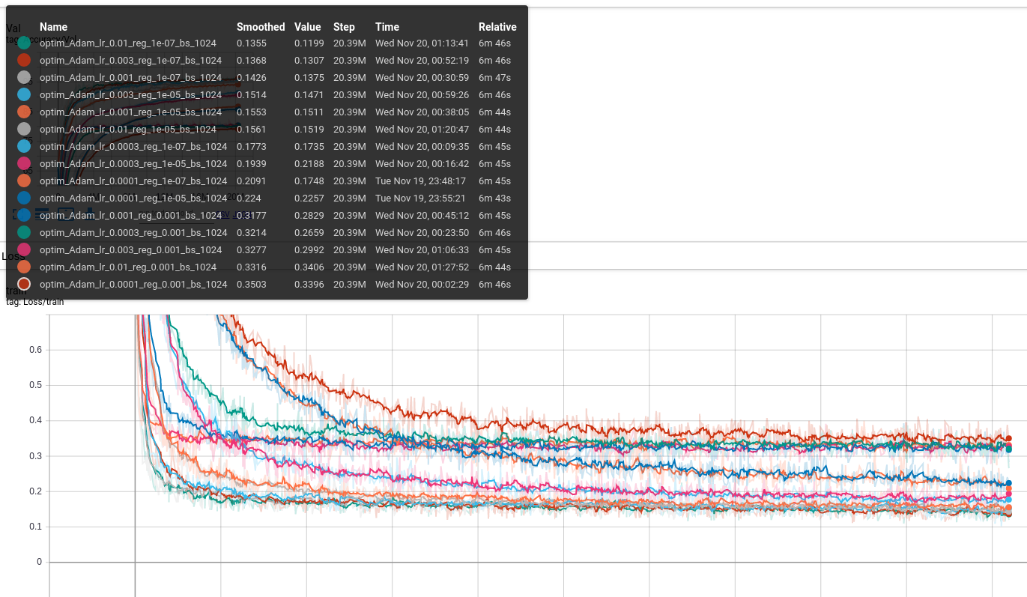
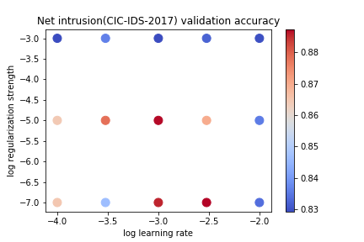
NN 3 layer: 1st run
Settings:
learning_rates = [1e-4,3e-4,1e-3,3e-3,1e-2]
regularizations = [1e-7,1e-5,1e-3]
Results:
Best val accuracy: 88.74
Need more epochs
Best parameters:(1e-3,1e-5)

Slide 21
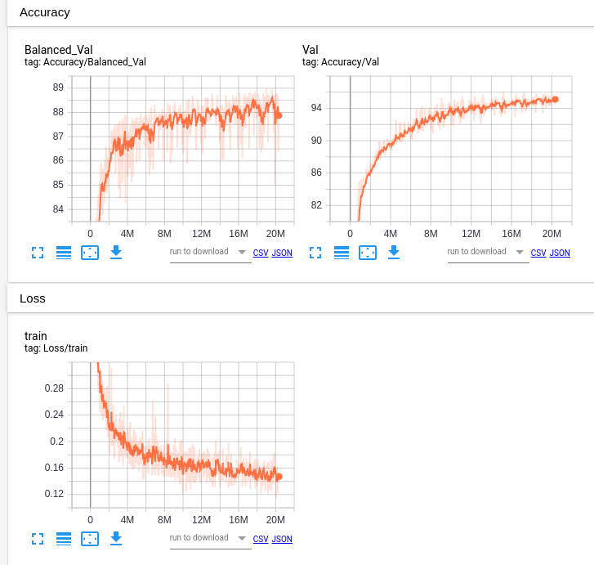
NN 3 layer: 2nd run with batchnorm
Settings:
learning_rates = [1e-3]
regularizations = [1e-5]
Num_epochs = 10
Use batchnorm
Results:
Best val accuracy:88.98, small improvement
Graph feedback: It is still learning. Need more epochs

Slide 22
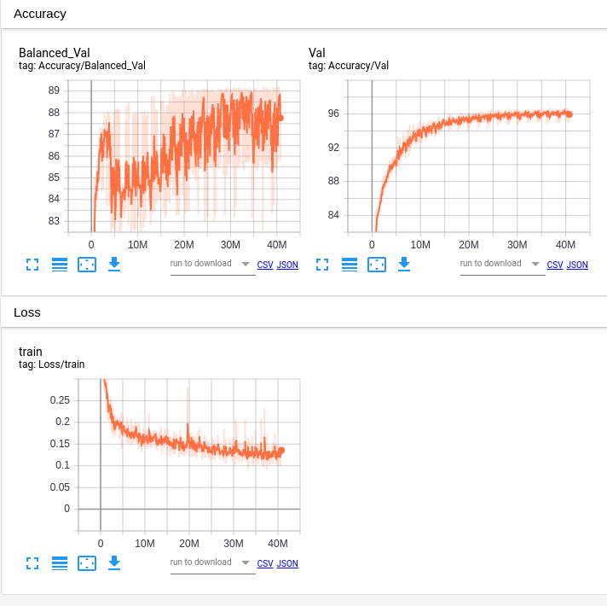
NN 3 layer: 3rd run with batchnorm + dropout
Settings:
learning_rates = [1e-3]
regularizations = [1e-5]
Use batchnorm
Use dropout (0.1,0.3)
num_epochs=20
Results:
Best val accuracy:89.22, small improvement
Test acc: 91.7

Slide 23
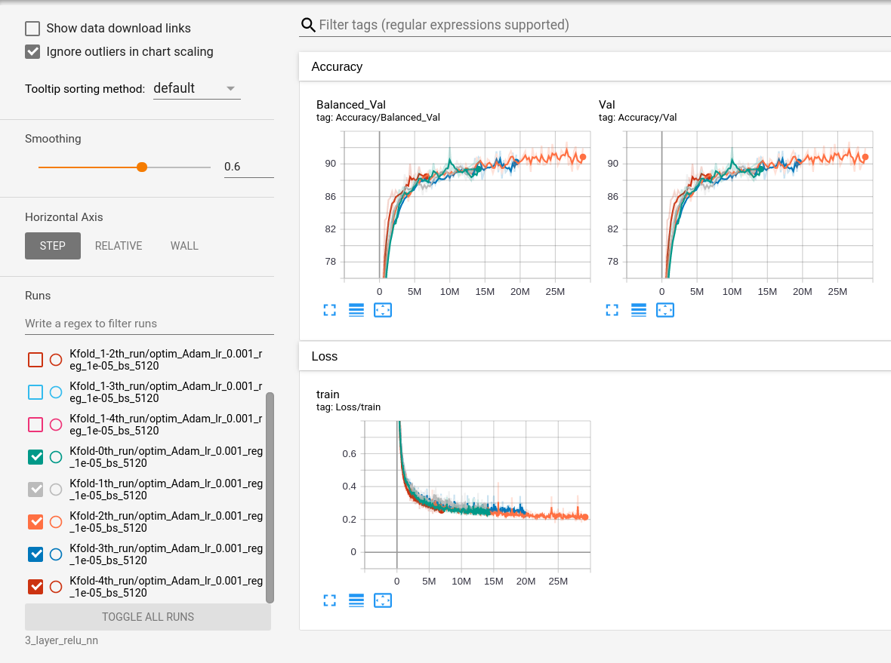
NN 3 layer: 5-Fold evaluation
Settings:
learning_rates = [1e-3]
regularizations = [1e-5]
Use batchnorm
Use dropout (0.1,0.3)
num_epochs=20
Results:
Balanced Test acc: 84.19

Slide 24
5 layer NN architecture
Batch size 1024 - GPU mem constraint(I recommend to use as large as possible DL class Inha)
Number of layers 5: (INPUT_DIM x 128 x 256 x 128 x NUM_CLASSES). Technically, we can try multiple configuration of hidden units but I am refraining because of computational cost (to reduce global warming)

Slide 25
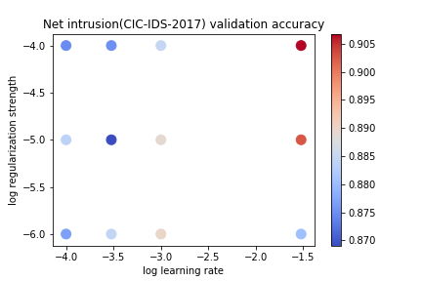
1st run: Dropout higher layers
Configurations:
learning_rates = [3e-2,1e-3,3e-4,1e-4]
regularizations = [1e-6,1e-5,1e-4]
Epoch = 20
Dropout prob: (0, 0, .3, .4, .5)
Results:
Val acc: 90.67
Test acc:91.15
Feedback:
Bigger reg
Bigger lr
Larger epoch

Slide 26
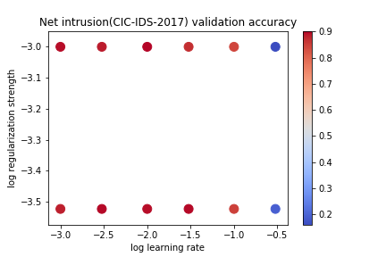
Run 2: Dropout higher layers
Configurations:
learning_rates = [1e-3,3e-3,1e-2,3e-2,1e-1,3e-1]
regularizations = [3e-4,1e-3]
Epoch = 60
Dropout prob: (0, 0, .3, .4, .5)
Results:
Val acc: 90.27
Test acc:87.28
Feedback:
Search does not have to be dense
Bigger reg range
smaller lr
Conflicting to previous run, it could be because of small epoch number previously

Slide 27
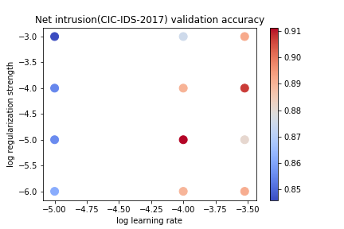
Run 3: Dropout higher layers
Configurations:
learning_rates = [1e-5,1e-4,3e-4]
regularizations = [1e-6,1e-5,1e-4,1e-3]
Epoch = 60
Dropout prob: (0, 0, .3, .4, .5)
Results:
Val acc: 91.14,
Test acc:89.12
Feedback:
Best param lr,reg = (1e-4,1e-5)

Slide 28
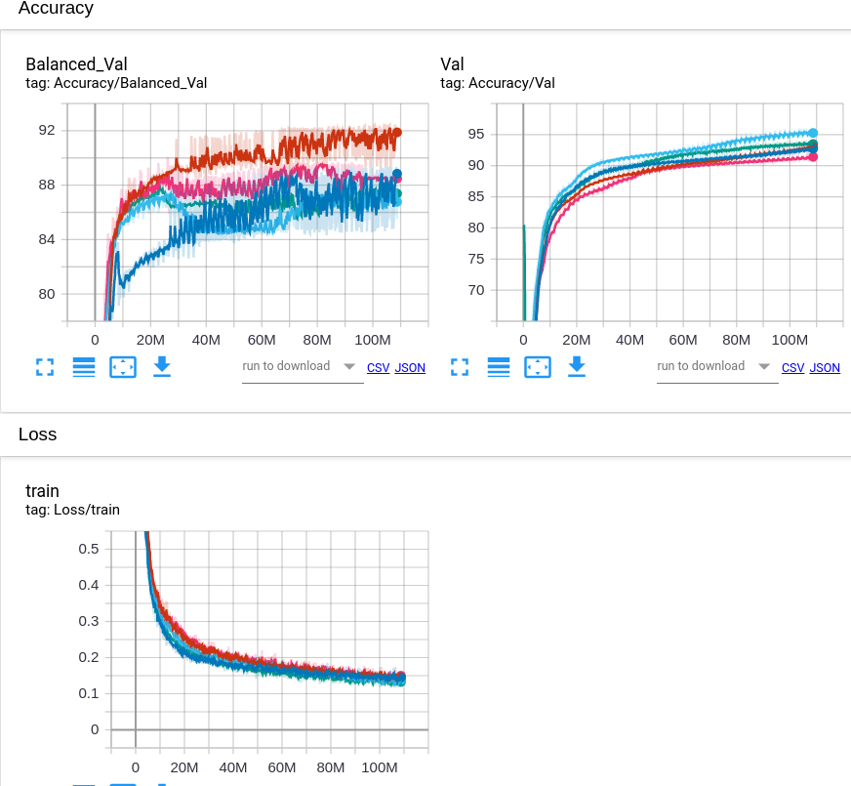
5-fold Evaluation: 5 layer NN
Settings
Best param lr,reg = (1e-4,1e-5)
Epochs = 60
Results:
5-Fold Balanced Test acc: 85.57

Slide 29
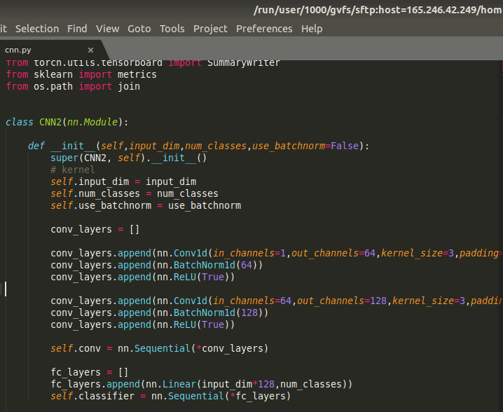
1D-CNN: 2conv+1fc layer
Although there is no spatial or sequence relation in the data still applying CNN
Num of params = 64*3*3 + 128*(64*3*3) + 76*128*15

Slide 30
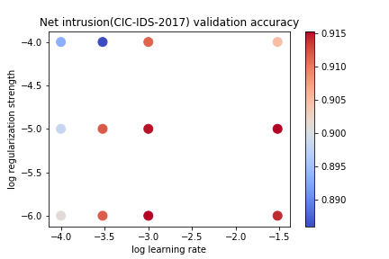
1D-CNN: run 1
Configs:
num_epochs = 60
learning_rates = [3e-2,1e-3,3e-4,1e-4]
regularizations = [1e-6,1e-5,1e-4]
acc:
Val:91.53
Test: 91.82
Feedback:
Lr 1e-3 is best, maybe need smaller reg

Slide 31
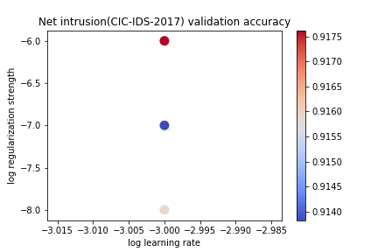
1D-CNN: run 2
Configs:
num_epochs = 60
learning_rates = [1e-3]
regularizations = [1e-8,1e-7,1e-6]
acc:
Val:91.76
Test:92.15
Feedback:
Best reg is 1e-6

Slide 32
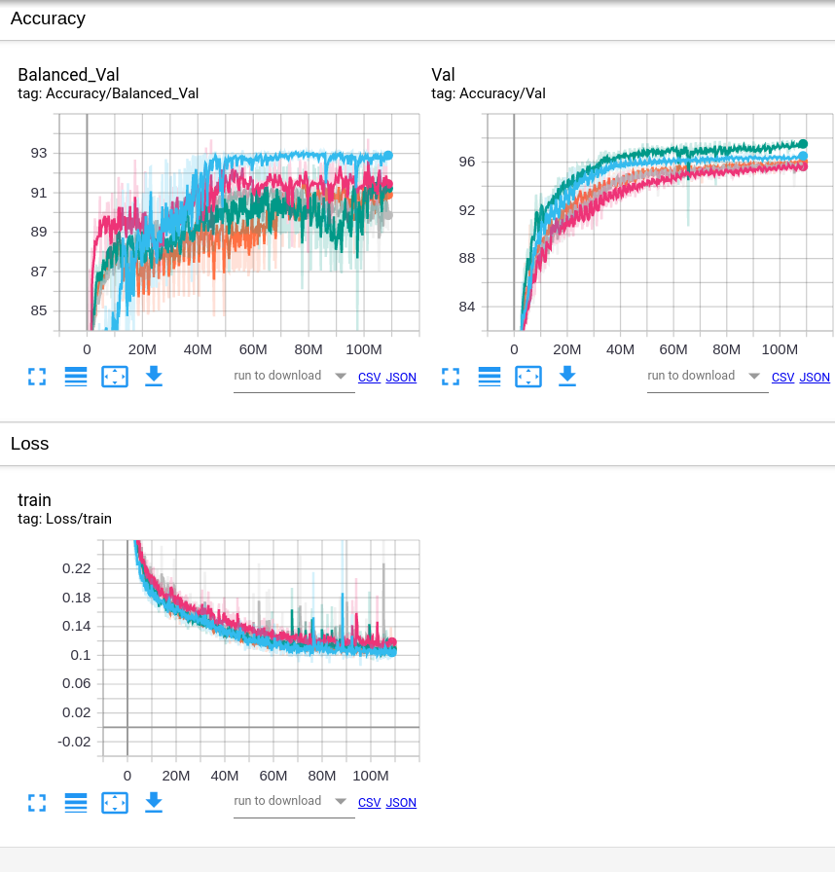
5-fold Evaluation: 2 layer 1D-CNN
Settings:
num_epochs = 60
learning_rates = [1e-3]
regularizations = [1e-6]
Results:
Each Fold results: 79.69%, 91.75%, 88.39%, 88.28%, 85.46%
5-Fold acc: 87.11%

Slide 33
Remove unimportant features
76 features
2830749 samples
...

Slide 34
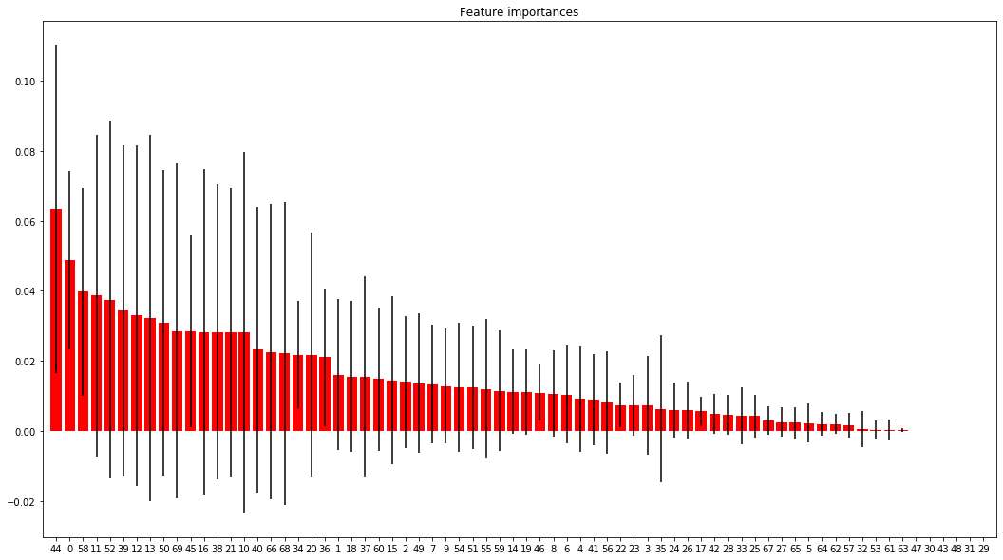
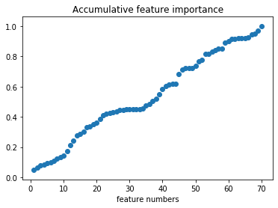
Remove unimportant features(Con’t)
importance
1. SKLearn, Forest Tree
2. So we keep the first 64 features and remain 92% information.
feature index

Slide 35
One-hot extension
Extend dataset from 2D to 3D
[-1, 1]
One-hot encode
scale value
2038140
(data num)
2038140
(data num)
32 extension
64 (feature)
64 (feature)

Slide 36
One-hot extension (Con’t)
Extend dataset from 2D to 3D
[-1, 1]
One-hot encode
scale value
2038140
(data num)
2038140
(data num)
32
32 extension
64 (feature)
64 (feature)
Now, we can say we get 2038140 images. An image size is (64, 32)

Slide 37
One-hot extension (Con’t)
Extend dataset from 2D to 3D
[-1, 1]
One-hot encode
scale value
2038140
(data num)
2038140
(data num)
32
32 extension
64 (feature)
64 (feature)
Example?
Now, we can say we get 2038140 images. An image size is (64, 32)

Slide 38
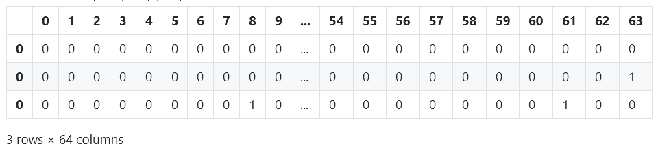
One-hot extension (Con’t)
Shape (3, 2, 32)
array([[[0, 0, 0, 0, 0, 0, 0, 0, 0, 0, 0, 0, 0, 0, 0, 0, 0, 1, 0, 0, 0,
0, 0, 0, 0, 0, 0, 0, 0, 0, 0, 0],
[0, 0, 1, 0, 0, 0, 0, 0, 0, 0, 0, 0, 0, 0, 0, 0, 0, 0, 0, 0, 0,
0, 0, 0, 0, 0, 0, 0, 0, 0, 0, 0]],
[[0, 0, 0, 0, 0, 0, 0, 0, 0, 0, 0, 0, 0, 0, 0, 0, 0, 0, 0, 0, 1,
0, 0, 0, 0, 0, 0, 0, 0, 0, 0, 0],
[0, 0, 0, 0, 0, 0, 0, 0, 0, 0, 0, 0, 0, 0, 0, 0, 0, 0, 0, 0, 0,
0, 0, 0, 0, 0, 0, 0, 0, 0, 0, 1]],
[[0, 0, 0, 0, 0, 0, 0, 0, 1, 0, 0, 0, 0, 0, 0, 0, 0, 0, 0, 0, 0,
0, 0, 0, 0, 0, 0, 0, 0, 0, 0, 0],
[0, 0, 0, 0, 0, 0, 0, 0, 0, 0, 0, 0, 0, 0, 0, 0, 0, 0, 0, 0, 0,
0, 0, 0, 0, 0, 0, 0, 0, 1, 0, 0]]], dtype=uint8)
2. Example
[[0.1, -0.1],
[0.3, 0.99],
[-0.5, 0.9]]
One-hot encoding
Extend 32
Shape (3, 2)
Or reshape to (3, 2 * 32)

Slide 39
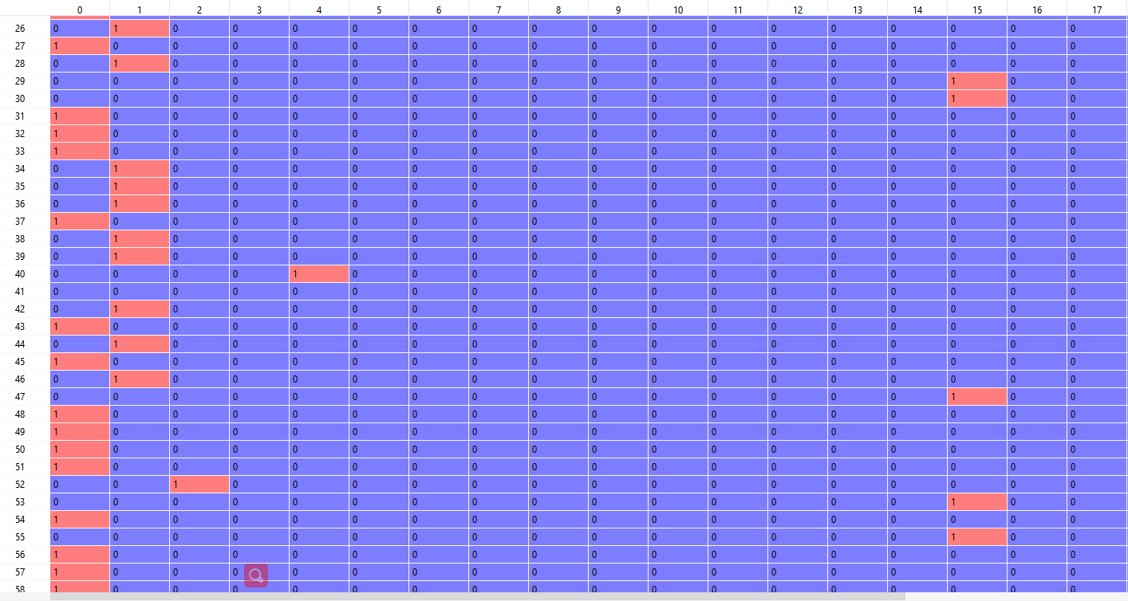
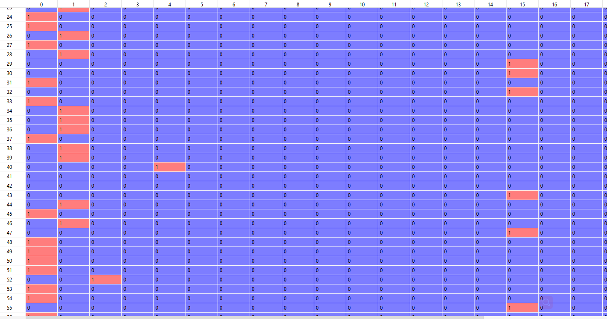
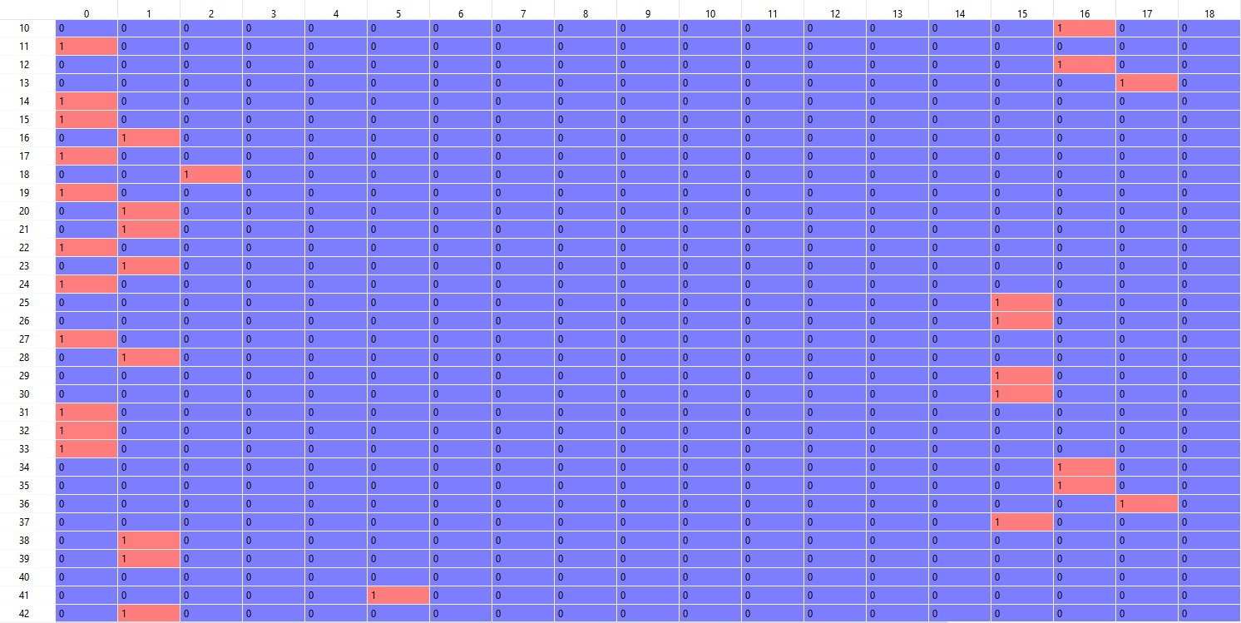
Extended Dataset, 2830740 images
Before extension, 843 MB,
After extension, 9.1 GB
Image 1, (64, 32)
Image 2, (64, 32)
Image 3, (64, 32)

Slide 40
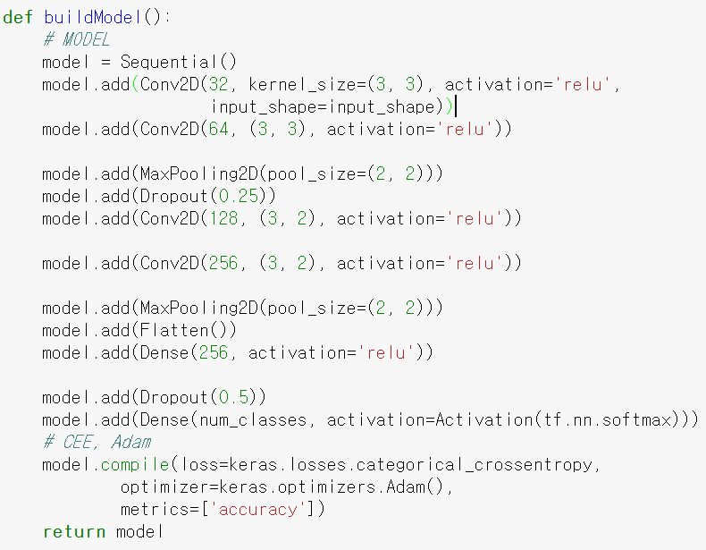
2D CNN
Layer (type) Output Shape Param #
=================================================================
conv2d_1 (Conv2D) (None, 62, 30, 32) 320
_________________________________________________________________
conv2d_2 (Conv2D) (None, 60, 28, 64) 18496
_________________________________________________________________
max_pooling2d_1 (MaxPooling2 (None, 30, 14, 64) 0
_________________________________________________________________
dropout_1 (Dropout) (None, 30, 14, 64) 0
_________________________________________________________________
conv2d_3 (Conv2D) (None, 28, 13, 128) 49280
_________________________________________________________________
conv2d_4 (Conv2D) (None, 26, 12, 256) 196864
_________________________________________________________________
max_pooling2d_2 (MaxPooling2 (None, 13, 6, 256) 0
_________________________________________________________________
flatten_1 (Flatten) (None, 19968) 0
_________________________________________________________________
dense_1 (Dense) (None, 256) 5112064
_________________________________________________________________
dropout_2 (Dropout) (None, 256) 0
_________________________________________________________________
dense_2 (Dense) (None, 15) 3855
=================================================================
Total params: 5,380,879
Trainable params: 5,380,879
Non-trainable params: 0
___________________________________

Slide 41
2D CNN
Experiment Setup
Tensorflow 1.1.0
Keras 2.2.2
Numpy 1.14.2
Pandas 0.23.4
GPU: GeForce GTX 1080 Ti
CPU: Intel(R) Core(TM) i5-8500 3.00GHz
RAM: 32.0GB

Slide 42
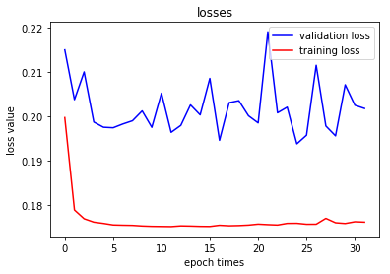
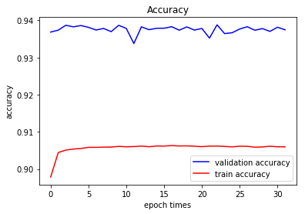
2D CNN
Training set: 2,038,140 samples
Validation set: 226,460
Test set: 566,149
Test accuracy: 0.939379

Slide 43
2D CNN, 5-Fold Cross-validation
Total: 2,264,596 samples
Training: 4/5
Validation: 1/5
 | Fold 1 | Fold 2 | Fold 3 | Fold 4 | Fold 5 | average
Train acc | 0.9144 | 0.9145 | 0.9147 | 0.9144 | 0.9147 | 0.9145
Val acc | 0.9136 | 0.9171 | 0.9174 | 0.9172 | 0.9167 | 0.9164

Slide 44
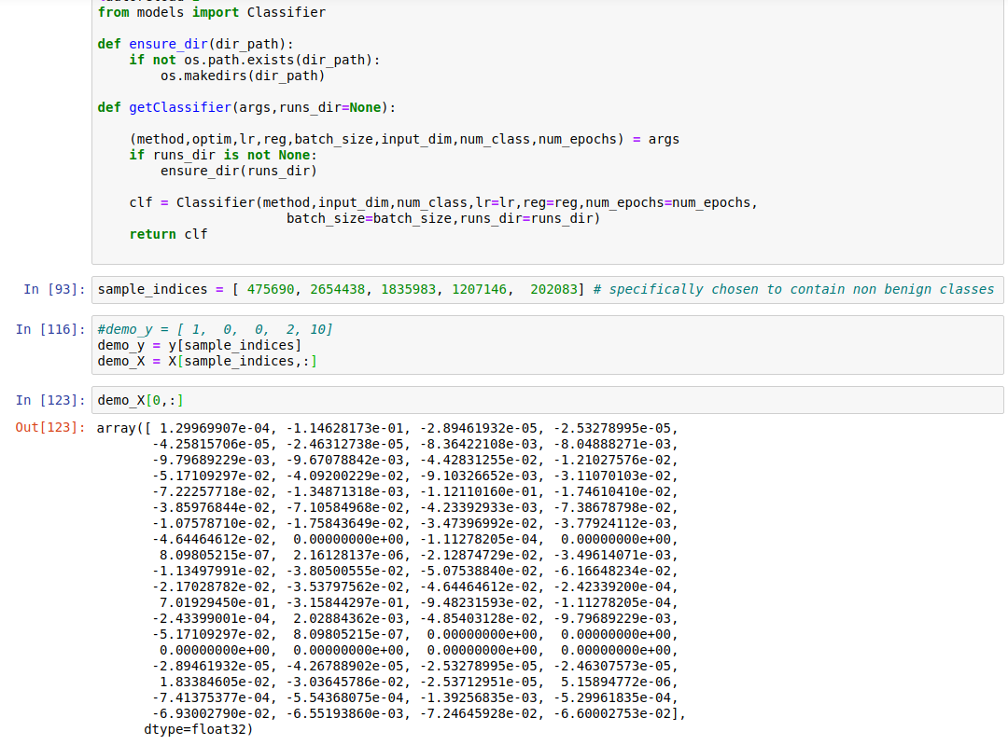
Demo
Deployment demo is hard
Choose 5 flows from dataset
Show one flow features for example

Slide 45
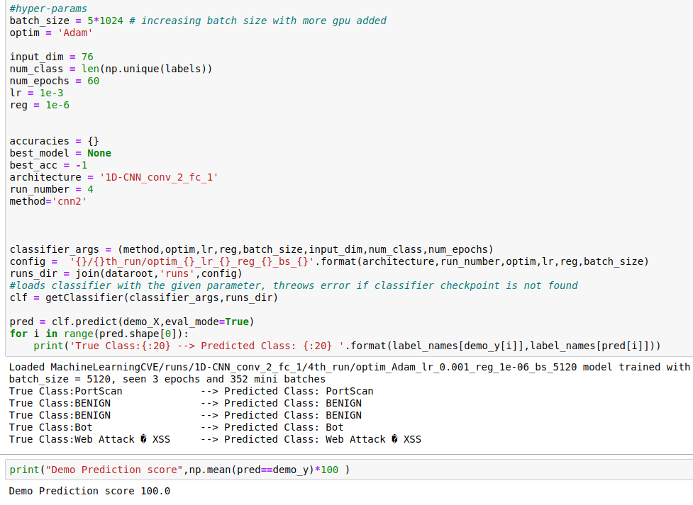
Demo (Cont.)
Load saved data
Make classification
1D-CNN: https://youtu.be/GKRD-MUEFmU

Slide 46
Conclusion
RF is most efficient
1D-CNN is applicable
2D-CNN is most powerful
Classifier | 5-fold Accuracy
RF | 84.41
Linear Softmax | 80.99
NN 3 layer | 84.19, 84.87
NN 5 layer | 85.57
1D-CNN 2 conv, 1 fc layer | 87.11, 86.71
Feature Selection + 2D-CNN 4 conv, 2 fc layer | 0.9164

Slide 47
Conclusion (Con’t)
Difficulty and Challenge:
Handling Imbalanced Data
Importance of proper accuracy metric for Imbalanced data
Necessity of K-Fold evaluation due to certain classes having small number of samples (Most Likely)
How to apply DL technology to this kind of dataset?
Large data set (in the case of 2D-CNN)
Before extension, 843 MB; After extension, 9.1 GB
About 3h to extend the dataset.
About 24h to train the model.

Slide 48
Contributions
Jumabek:
Project Idea
train/eval pipeline, proper evaluation metric, train/eval and backbone code
RF,NN,1D-CNN
https://github.com/Jumabek/net_intrusion_detection
Liang Yihuai:
Feature Engineering for important features, code and notebook: [here]
One-hot encoding extension, code and notebook: [here]
2D CNN, code and notebook: [here]
Tehreem Syed:
Softmax Classifier

